Slide 1
RT-512 Livelihood And Entrepreneurship
By: sushant swarup
M.Tech. 1st year
224154008
S.A.R.T.

Slide 2

A FRUIT JUICE AND SALAD SHOP

Slide 3
TABLE OF CONTENT
INTRODUCTION
IDEATION AND MARKET ASSESSMENT
FINANCIAL ANALYSIS
RISK ANALYSIS
ENVIRONMENTAL AND SOCIAL ANALYSIS
SWOT ANALYSIS

Slide 4
INTRODUCTION
Fresh fruit products are foods that are made from freshly harvested fruits and sold in the market.
It includes Fresh whole fruits, cut fruits plates, Fruit salads, Fruit smoothies, Dried fruits, Fruit preserves and Fruit juices
Goal: To expand the market reach and value of fresh fruit juices.
Scope: Availability of fruit products especially juices, their varieties, sales, raw material data collection, wastage of fruits as raw form as well as in form of pulp or peels etc.,
Boundaries: Hostel’s juice canteens.

Slide 5
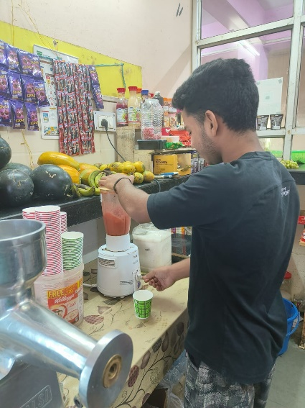
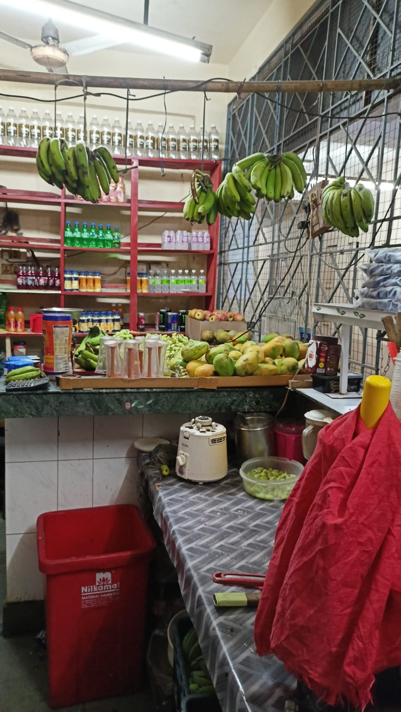
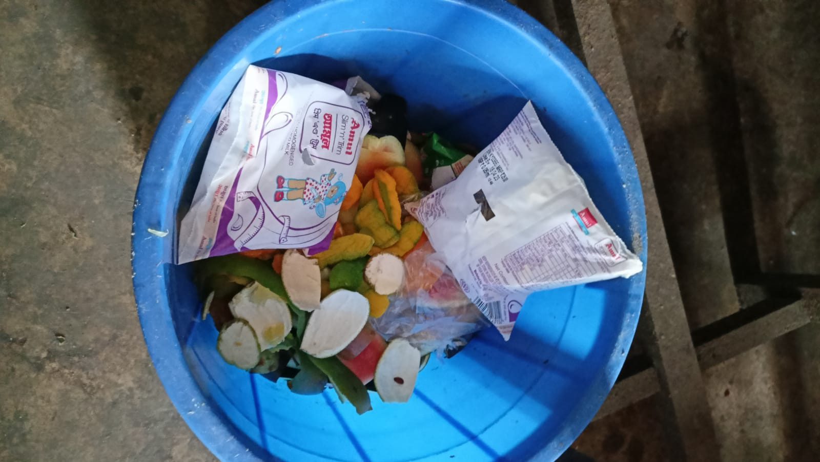
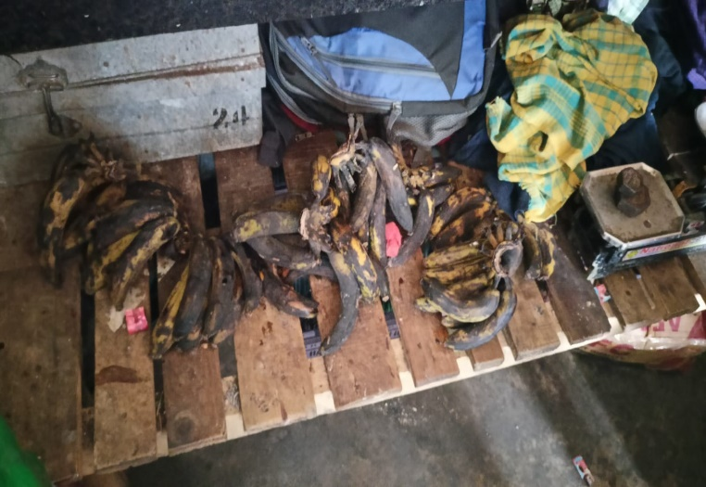
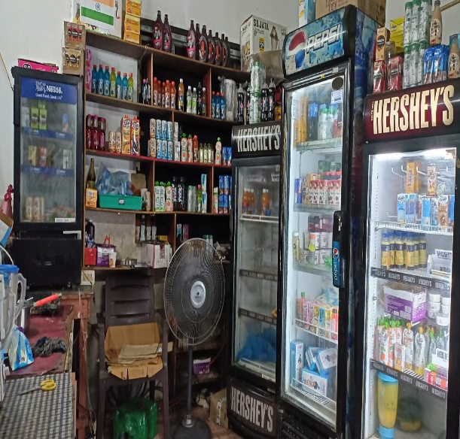
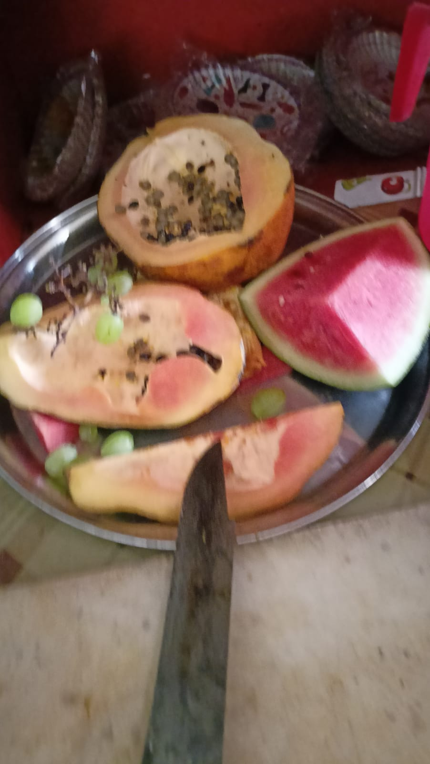
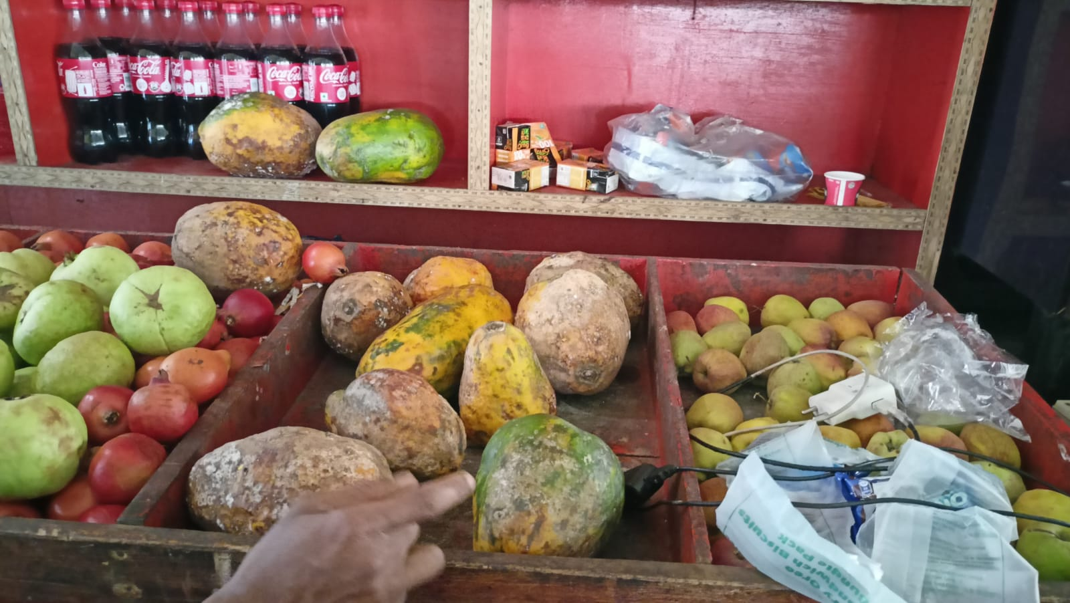
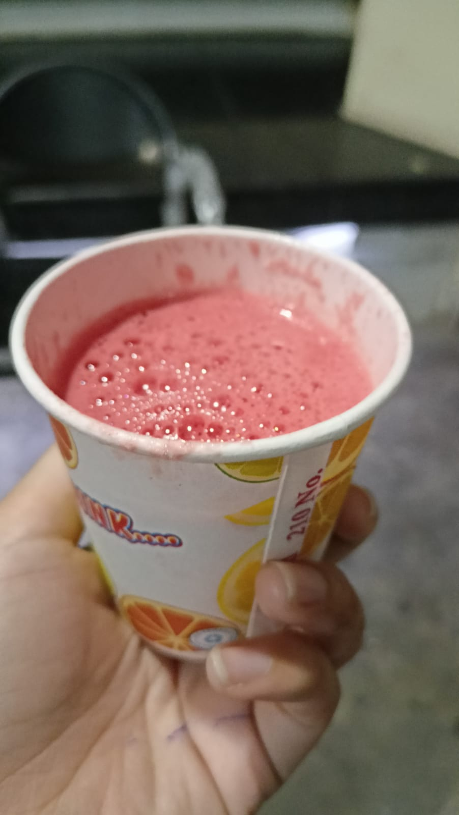
MARKET ASSESSMENT
Location: Dhansiri canteen.
Menu Options: All seasonal fruit juices and salads, fruit shakes and also juices and salads of mixed fruits.
I have conducted survey in 4-Hostels, Dhansiri, Subhansiri, Kameng, Lohit.
It has been found out that the sale of packed products is more than that of the fresh-fruit juices.
It is mainly due to unhygienic environment in canteen, poor quality of fruits, lack of variety and presentation is also not good.
Since, it is a healthy option, people want to consume. So, market size as well as demand is high, the requirement is that we need good quality fruit juice centers.
Fruit juice is a great business to start. Idea and market is good, only execution part needs some brainstorming and innovation.
Idol: Korean Live fruit juice center and MBA Chai-wala

Slide 6
FINANCIAL ANALYSIS
Start-up Costs:
Total start-up costs: INR 1,47,000
Fixed Costs:
Total fixed costs: INR 81,083 per month
Variable Costs:
Total variable costs: INR 9,950 per day
Revenue:
Total revenue: INR 19,500 per day
Break-even Analysis:
Fixed Costs: INR 81,083 per month
Contribution Margin (Revenue - Variable Costs): INR 9,550 per day
Break-even Point (Total Fixed Costs / Contribution Margin): 8.5 days
Profitability Analysis:
Gross Profit (Revenue - Cost of Goods Sold): INR 9,550 per day
Gross Profit Margin (Gross Profit / Revenue): 49%
Net Profit (Gross Profit - Fixed Costs): INR 7,466 per day
Net Profit Margin (Net Profit / Revenue): 38%
Based on the above analysis, the project is expected to generate profit and break-even within the first 9 days of operation.

Slide 7
ENVIRONMENTAL AND SOCIAL ANALYSIS
Promote healthy and sustainable food choices on campus.
Prioritize the use of locally-sourced and organic produce, which will reduce the carbon footprint.
Proper waste management and energy conservation.
Hire and train staff members from the local community, providing them with valuable skills and employment opportunities.
Source our ingredients from local farmers and suppliers, which will support the local economy

Slide 8
SWOT ANALYSIS
Strengths:
Unique product offerings
Location
Experienced management team
Weaknesses:
Competition
Limited menu options
Limited operating hours
Opportunities:
Growing demand for healthy food options
Potential for expansion
Collaborations with other businesses
Threats:
Economic downturn
Changes in regulations
External factors such as natural disasters or pandemics

Slide 9
ANY QUESTIONS??

Slide 10
THANKYOU

